Slide 1


Week 4
1

Slide 2
Index
2
Sr no | index
1 | Week5Sketch1
Sr. no
1
2
3
4
5
Contents
Week1Sketch1
Week1Sketch2 Week1Assignment1
Week1Assignment2 Insights

Slide 3
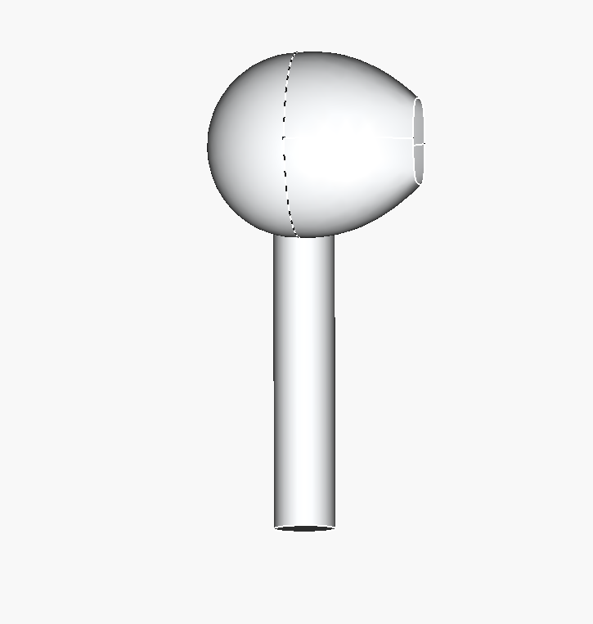
Week5Sketch1
Learn about loft tool
Learned about real life component and increased thinking about how to design it such way that can be used in real life

